Slide 1
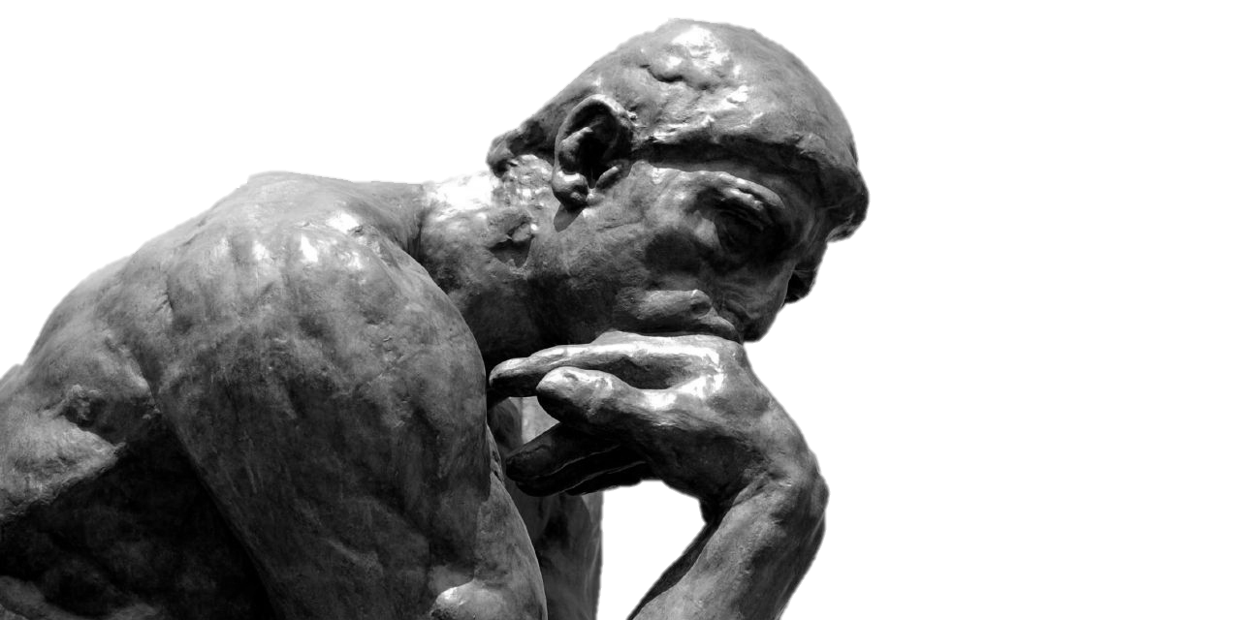
APOLOGETICS 101
Andrew Foland, M.A.A.
RCIUPUI.org
andrewfoland@ratiochristi.org
Notes:
I’ll let you in on a secret: I’m what you might call a “curious Christian.” If we were to spend time getting to know one another, I’d enjoy learning all about the wonderful things that make you, you. Afterall, God made only 1 you and you are special in God’s eyes. But I’d be curious about 2 things in particular about you: 1) “What are your spiritual beliefs?” 2) “Why?” “What is your evidence?” “Should I believe what you do? Should you believe what I do? How can we know?” Welcome to apologetics 101..

Slide 2
1 Peter 3:15 “Sanctify Christ as Lord in your hearts. Always be ready to give a defense [apologia] to everyone who asks you to give an account for the hope that you have, yet with gentleness and respect.”
Proper Expectations:
Convey, not convert
“Proof”?
You can do it!
Notes:
1 Pet. 3:15 – Three commands: 1) Set apart Christ as Lord; 2) Defend why you believe; 3) Defend with gentleness and respect.
H.S. converts. You lead them to water. Only the H.S. can make them drink.
2. Proof = well-reasoned argument, not mathematical certainty
2. The nature of truth is absolute but our knowledge of it is not always certain. Nevertheless, we can have good reason to believe we have truth even if those reasons are not certain. We can know absolute truth exists even if we don’t have absolute knowledge of it. We can have adequate knowledge.
Just as I can’t be certain of any historical event but I have enough confidence to call it true.
3. You don’t need to be a genius. You just need to be willing to apply yourself. And I can’t think of a more important topic to apply yourself toward than God.

Slide 3
1 Peter 3:15 “Sanctify Christ as Lord in your hearts. Always be ready to give a defense [apologia] to everyone who asks you to give an account for the hope that you have, yet with gentleness and respect.”
APOLOGETICS – REASONED DEFENSE
Defensive Arguments (Answer Objections) | Offensive Arguments (Provide Evidence)
2 Cor. 10:5 “We are destroying speculations and every lofty thing raised up against the knowledge of God, and we are taking every thought captive to the obedience of Christ.” | Acts 1:3 “After His [Jesus] suffering, He showed Himself to these men and gave many convincing proofs that He was alive.”
Notes:
Defense responds to attacks. What are some attacks on the faith?
Offensive = a positive case.

Slide 4
1 Peter 3:15 “Sanctify Christ as Lord in your hearts. Always be ready to give a defense [apologia] to everyone who asks you to give an account for the hope that you have, yet with gentleness and respect.”
APOLOGETICS – REASONED DEFENSE
Defensive Arguments (Answer Objections) | Offensive Arguments (Provide Evidence)
Moral Objections Scientific Objections Historical Objections Attacks on the Bible Cultural Objections Theological Objections
Notes:
Moral Objections – POE / HOG
Scientific Objections - Evolution
Historical Objections – Adam and Eve, Exodus
Attacks on the Bible – alleged contradictions, genocide, slavery, etc…
Cultural Objections – LGBTQ, CT, Abortion, “Dangers” of religion
Theological Objections – Trinity, Hell, Hypostatic Union, Exclusivity of Christ, etc…
The Positive Case
Gives your opponent something to think about.
If the positive case is true, the objections fall to the wayside.

Slide 5
Jesus
God
Theism
Bible
truth
Christianity
Notes:
Yellow = Step 1 -- Theism
Blue = Step 2 – Christianity
The bottom row acts as an epistemic foundation for the top row. Because there is truth, we can know God. The Bible is the best historical (though not the only) knowledge of Jesus and if the Bible is historically credible, Jesus follows.

Slide 6
Truth is what corresponds to its referent.
Truth is the actual factual!
truth
Many people today believe that truth is relative.
But the nature of truth is absolute.
Notes:
Truth is “telling it like it is.”
Truth is not just what works, or my perspective
Absolute Truth – Truth for all people, at all times, in all places (given its universe of discourse.)
Relative truth – only true for some people, at some times, in some places

Slide 7
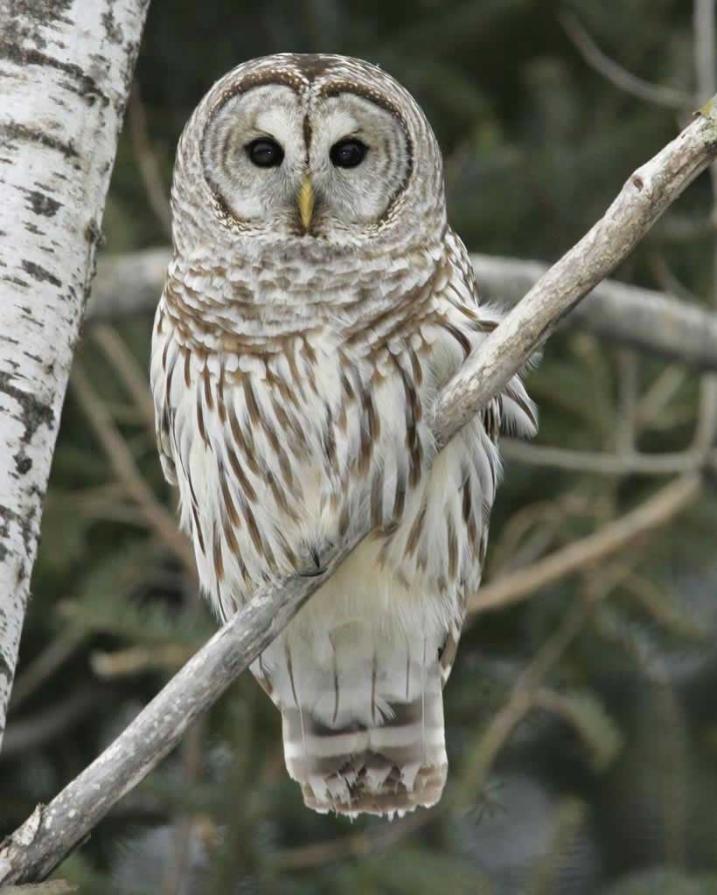
“Why give a Hoot?”
Religious and ethical claims are predicated on truth.
Relativists think each person can have his/her “truth.”
If Relativism is true, nothing else we say today matters!
Notes:
Religion is not a matter of opinion; it is a matter of truth. It makes truth claims, not opinion options.
“Your” truth v. “The” truth
“Let’s celebrate our different faiths.”

Slide 8
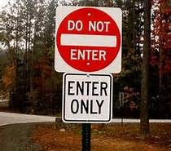
(The Absolute Downfall of Relativism)
1. Opposites can’t both be true!
Notes:
Relativism entails opposites both being true. This would mean relativism is true and not true at the same time and sense.
You don’t see this for a good reason!
Relativism says your truth is just as valid as mine even if they contradict.

Slide 9
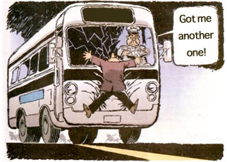
(The Absolute Downfall of Relativism)
1. Opposites
Your “truth”:
“The bus will hit you!”
My “truth”:
“The bus won’t hi…...”

Slide 10
(The Absolute Downfall of Relativism)
1. Opposites
Christian: “Jesus is the Son of God.”
Muslim: “Jesus is not the Son of God.”
Notes:
Relativism entails a world of contradictions.
In matters of religion and ethics, people confuse truth with beliefs. We can believe opposites. But only one is true.
Messiah v. not messiah
God exists v. doesn’t exist
If Jesus is truly God and claimed to be the only way, then He is, like it or not.
Distinction: truth v. opinion/belief/perspective

Slide 11
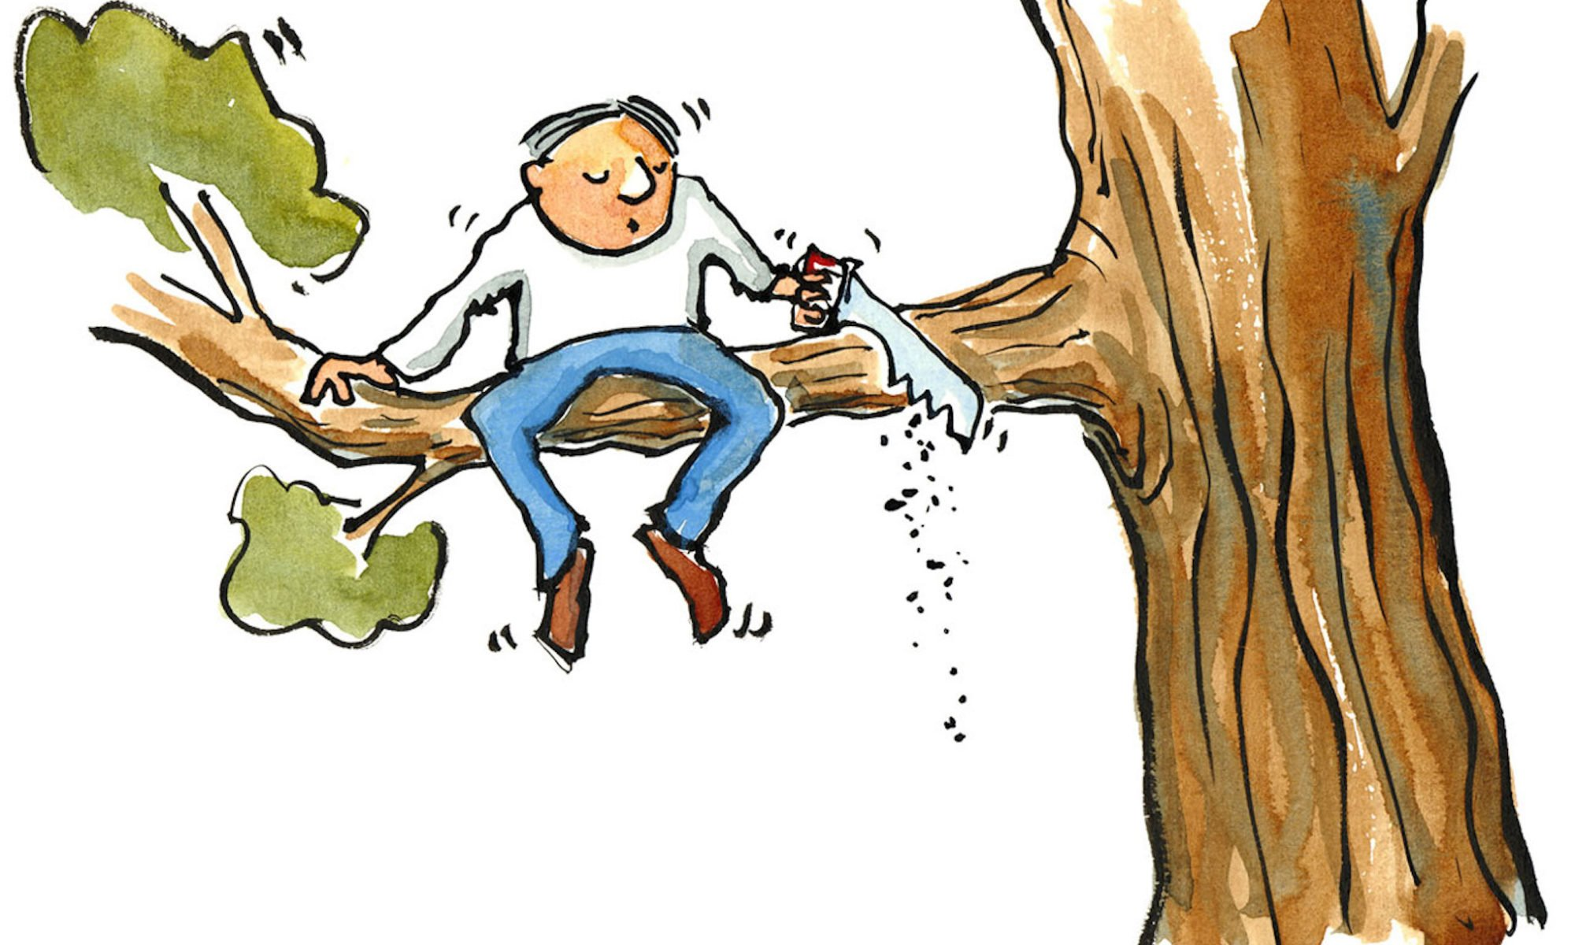
2. Self-Defeating
“There are no absolute truths. Absolutely!”
Relativists believe that relativism is true for everyone everywhere.
Notes:
The claim defeats itself. It doesn’t live up to its own standards.
Relativists sit on the branch of relativism and then saw it off with an absolute claim.
Illustration: My Student Story

Slide 12
Jesus
God
ABSOLUTE
Nature
Bible
truth
Notes:
Absolute truth means if Christianity is true, the following objections fail:
Many roads to salvation
We determine our truth.
“Go find what is true for you.” No! “Go find what is true!”
Your opinions/preferences must submit to truth rather than the other way around!

Slide 13
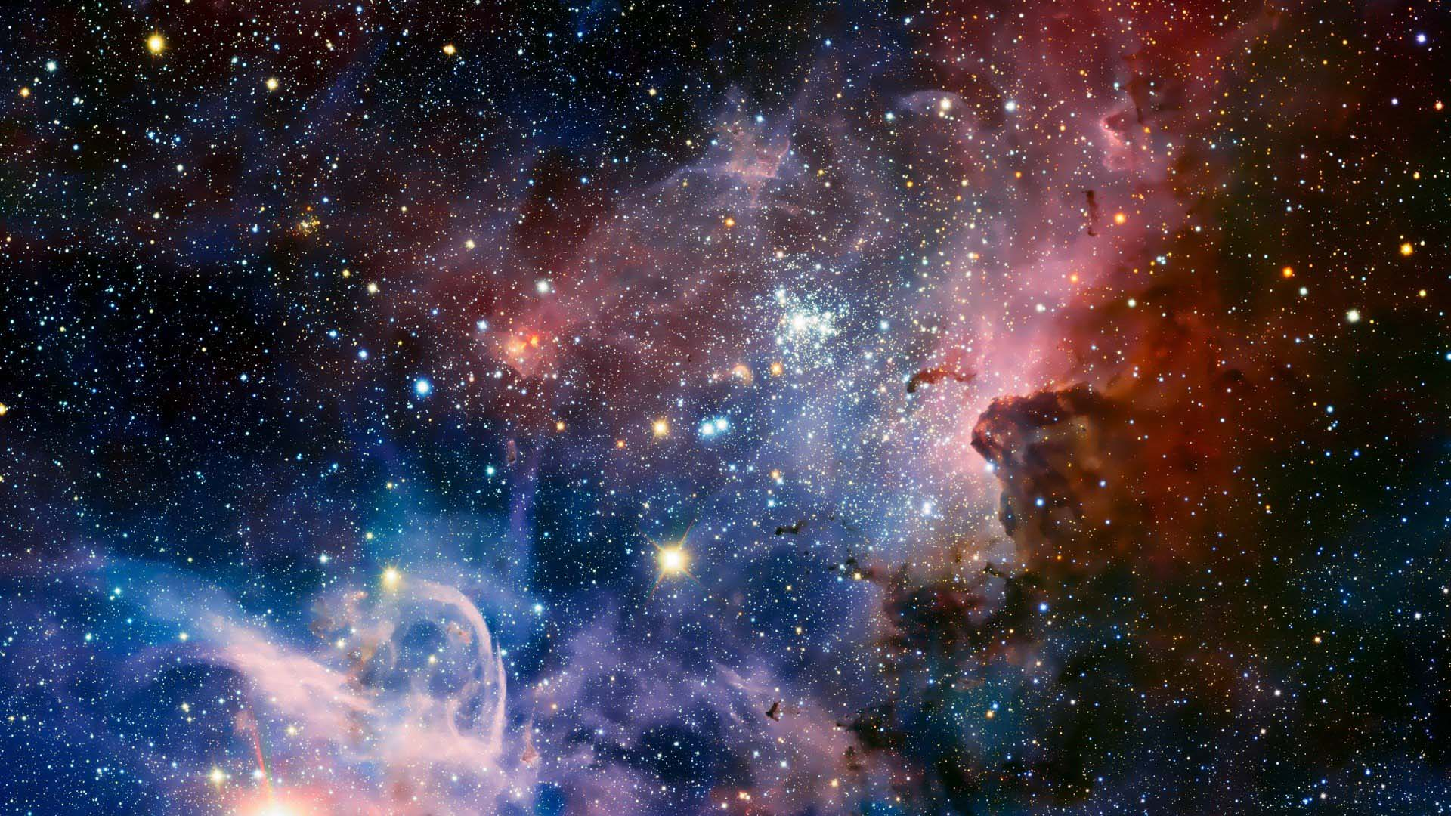
God’s
Existence
God
Cosmological Arguments
Intelligent Design Arguments
Notes:
Increasingly, people are rejecting God, the prerequisite to:
“God loves you.”
“You’ve sinned against God.”
“Jesus is the Son of God.”
“The Bible is the Word of God.”

Slide 14
A Mother and Son Go For a Walk

Slide 15
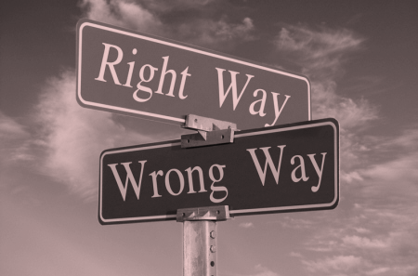
ABSOLUTE Moral Values
Notes:
We intuitively know that the mother’s actions were wrong – absolutely wrong. Not just unpopular. Not just socially taboo. But what accounts for their absolute wrongness? Clearly, there is some absolute moral standard of which she falls far short. What is the foundation of this standard?

Slide 16
ABSOLUTE Moral Values
1. Every law has a lawgiver.
2. There is an absolute moral law.
3. Therefore, there is an absolute
Moral Lawgiver.

Slide 17
ABSOLUTE Moral Values
1. Every law has a lawgiver.
2. There is an absolute moral law.
3. Therefore, there is an absolute
Moral Lawgiver.

Slide 18
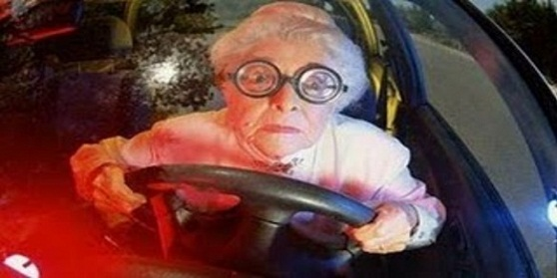
Every law has a lawgiver.
Officer:
“No speeding!”
Driver:
“Says who?”
Notes:
Instead of replying, “Our lawmakers/governing officials, etc…” officer Daisy Dukes replies to the lady: “No one.” This would make no sense. Laws don’t come from nowhere.
Effects like laws have causes (lawmakers). They don’t come from nowhere.

Slide 19
Every law has a lawgiver.
Customer: “Can I have some drugs?!
I've got a prescription.”
Pharmacist: “Who prescribed it?”
Customer: “No one. It's just a prescription.”
Notes:
Moral laws are moral prescriptions – ought and ought not.
Prescriptions need prescribers.

Slide 20
ABSOLUTE Moral Values
1. Every law has a lawgiver.
2. There is an absolute moral law.
3. Therefore, there is an absolute
Moral Lawgiver.
Notes:
Absolute – objective, perpetual, universal obligation
Moral – Something good in itself
-- Is v. Ought
Is = description
Ought = prescription - Obligation - expectation

Slide 21
There is an Absolute Moral Law (AML).
Good questions to draw out the moral law within:
*What person does not expect to be treated as a person?
*Who ever actually believed that murder, rape, or cruelty
to children was morally right (or indifferent)?
*Who ever actually believed that it was right to take what
belonged to anyone at any time?
*Do you really believe there is nothing wrong anywhere?

Slide 22
ABSOLUTE Moral Values
1. Every law has a lawgiver.
2. There is an absolute moral law.
3. Therefore, there is an absolute
Moral Lawgiver.

Slide 23
Notes:
The blue surface represents what we know to be true about morality (namely, there is absolute right and wrong.) The hole represents a gap in our knowledge (that is, Who or what is the foundation of morality, or our Absolute Law Giver?) The peg will need to fit, namely be absolute as opposed to relative.

Slide 24
Relative Moral Foundation
Notes:
As we see a foundation, we want to be sure we aren’t trying to fit a square peg in a round hole. We want the foundation to match the rest of reality. In other words, they need to be consistent. They need to line up. They need to make sense with each other.
Just as we need a peg that fits the description of the hole, so too we need a Lawgiver that fits the description of AML.

Slide 25
Whodunit? (Grounds Morality) Suspect Lineup
Relativism
Absolutism
X
X
X
X
Cultural
Humanity as a whole
Individualism
Biology
God
Notes:
Admittedly, these are not all the possibilities but they are the main ones.
Biology - The idea that we should behave like nature is morally reprehensible to us. Plus, our natural impulses are sometimes wrong. Hence, we have a moral accountability above that of nature. Moral prescriptions from impersonal forces. Is/ought fallacy.
God is that round peg Absolute that fits as a foundation for what we know about morality. God is absolute. God is personal.

Slide 26
Jesus
God
Law Giver
ABSOLUTE
Nature
Bible
truth
Notes:
If God exists, miracles are possible!

Slide 27
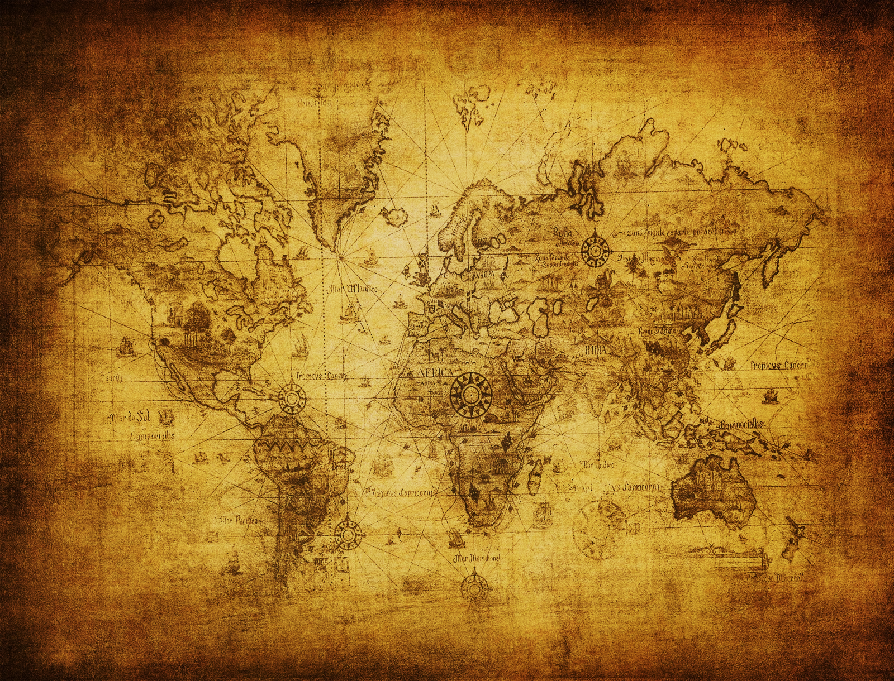
M.A.P.
M = Manuscript
A = Archaeology
P = Prophecy
Notes:
M, A = Historical Reliability
P = Divine Inspiration – This gives the Bible authority.

Slide 28
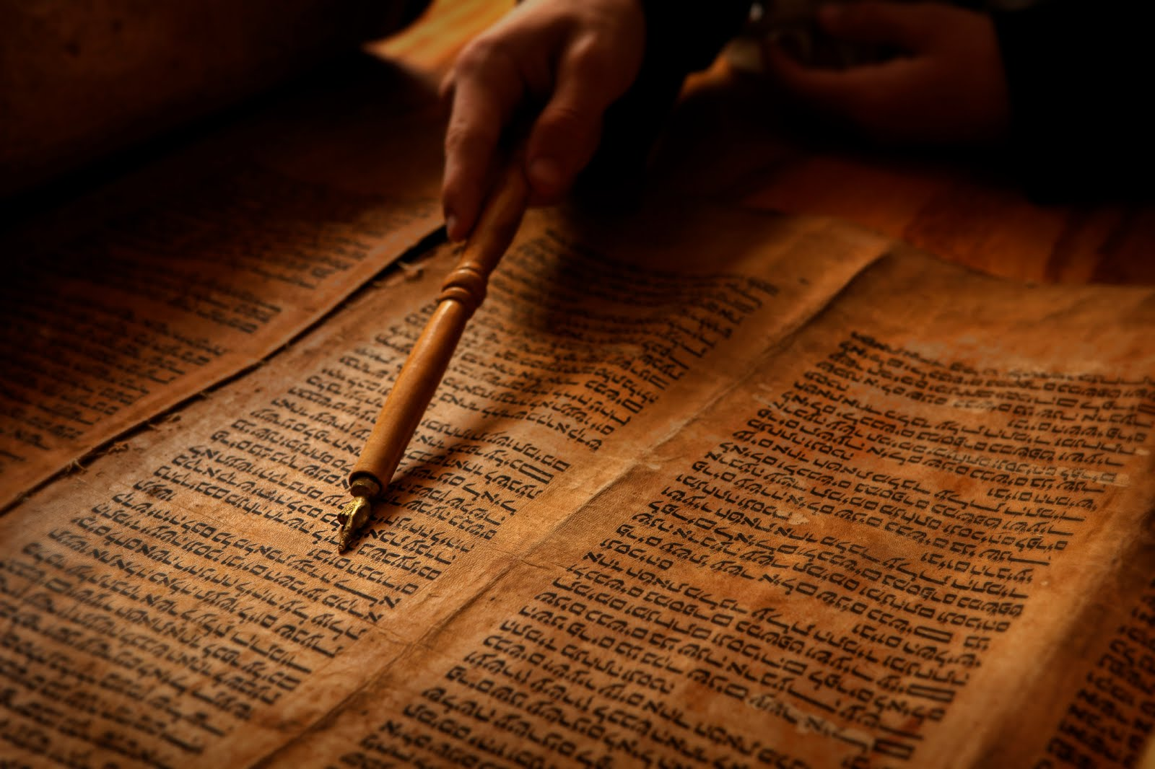
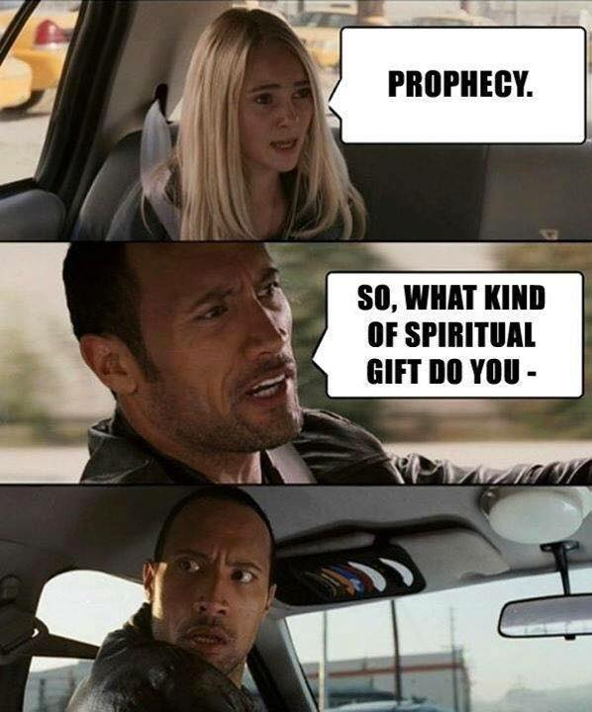
Foretelling Prophecies

Slide 29
Foretelling Prophecies
According to J. Barton Payne,
of the 31,124 verses in the Bible, 8,352 (27%) involve predictive prophecy.

Slide 30
Foretelling Prophecies
Short Range (same generation) - Isaiah 37:6-7; Jer. 28:15-7; Ezek. 24:1-2; Zech. 4:9
Medium Range (next generations) - Isaiah 44:28, 45:1, 39:6-8, 43:3; 1 Kings 13:1-10
Long Range (many generations) - Isaiah 53; Psalm 22; Dan. 9:25-6; Zech. 12:10; Micah 5:2
Notes:
Foretelling Prophecy was a way a prophet could be tested by the Hebrews to see if he was a true messenger of God.

Slide 31
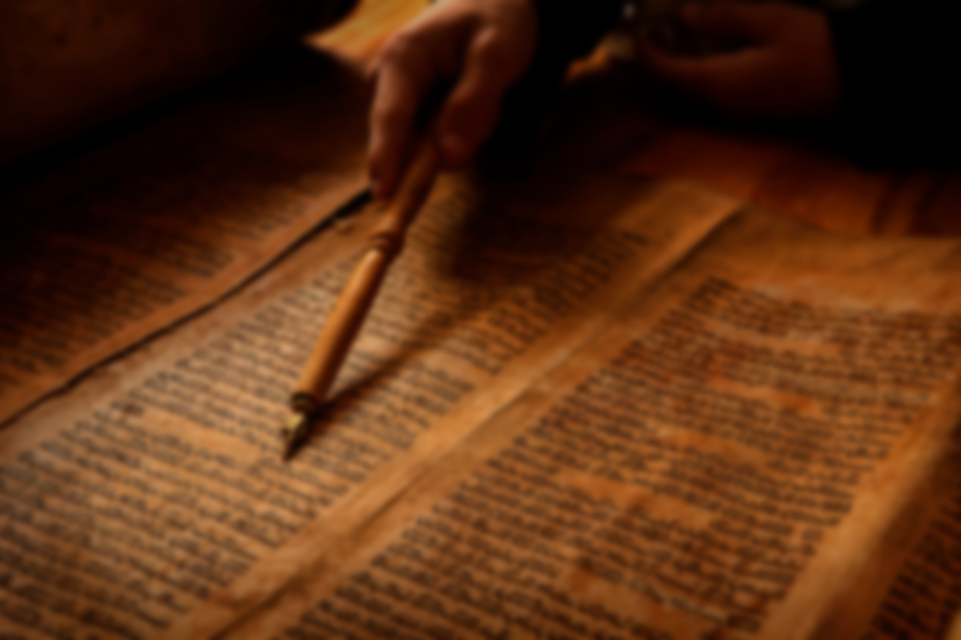
Short Range -- Isaiah 37:6-7, 33-35
(6) Isaiah said to them…, “Thus says the LORD, ‘Do not be afraid because of the words which the servants of the king of Assyria have blasphemed Me.
(7) Behold, I will put a spirit in him so that he shall hear a rumor and return to his own land. And I will make him fall by the sword in his own land....’
(33) ‘…[the king of Assyria] shall not come to this city nor shall he come before it with a shield, nor throw up a mound against it.
(34) By the way that he came, by the same he shall return, and he shall not come to this city,’ declared the LORD.
(35) ‘For I will defend this city to save it for My own sake and for My servant David’s sake.’”
Notes:
Isa. 37 – Context: Assyria is destroying Judah and threatening to destroy Jerusalem. Hezekiah, sent elders to speak about the impending doom with Isaiah.
According to 1st century A.D. Jewish historian Josephus, Berosus of Chaldea (a 4th century B.C. Babylonian priest and historian) recorded the following: “Now when Sennacherib was returning from his Egyptian war to Jerusalem, he found his army under Rabshakeh his general in danger [by a plague], for God had sent a pestilential distemper upon his army; and on the very fist night of the siege, a hundred fourscore and five thousand, with their captains and generals, were destroyed, so the king was in a great dread, and in a terrible agony at this calamity and being in great fear for his whole army, he fled with the rest of his forces to his own kingdom, and to his city Nineveh; and when he had abode there a little while, he was treacherously assaulted, and died by the hands of his elder sons, Adrammelech and Seraser, and was slain in his own temple, which was called Araske.” (Quoted from Josephus, Antiquity of the Jews 10.1.5)
Herodotus records that mice swarmed Sennecherib’s camp eating their bows and armor causing them to retreat (Josephus, Antiquity, 10.1.4)
Bottom Line – Isaiah’s prophecy was clear and specific

Slide 32
Short Range -- Isaiah 37:6-7, 33-35
(6) Isaiah said to them…, “Thus says the LORD, ‘Do not be afraid because of the words which the servants of the king of Assyria have blasphemed Me.
(7) Behold, I will put a spirit in him so that he shall hear a rumor and return to his own land. And I will make him fall by the sword in his own land....’
(33) ‘…[the king of Assyria] shall not come to this city nor shall he come before it with a shield, nor throw up a mound against it.
(34) By the way that he came, by the same he shall return, and he shall not come to this city,’ declared the LORD.
(35) ‘For I will defend this city to save it for My own sake and for My servant David’s sake.’”
Notes:
Isa. 37 – Context: Assyria is threatening to destroy Jerusalem. Judah’s King, Hezekiah, sent elders to speak about the impending doom with Isaiah.
According to 1st century A.D. Jewish historian Josephus, Berosus of Chaldea (a 4th century B.C. Babylonian priest and historian) recorded the following: “Now when Sennacherib was returning from his Egyptian war to Jerusalem, he found his army under Rabshakeh his general in danger [by a plague], for God had sent a pestilential distemper upon his army; and on the very fist night of the siege, a hundred fourscore and five thousand, with their captains and generals, were destroyed, so the king was in a great dread, and in a terrible agony at this calamity and being in great fear for his whole army, he fled with the rest of his forces to his own kingdom, and to his city Nineveh; and when he had abode there a little while, he was treacherously assaulted, and died by the hands of his elder sons, Adrammelech and Seraser, and was slain in his own temple, which was called Araske.” (Quoted from Josephus, Antiquity of the Jews 10.1.5)
Herodotus records that mice swarmed Sennecherib’s camp eating their bows and armor causing them to retreat (Josephus, Antiquity, 10.1.4)
Bottom Line – Isaiah’s prophecy was clear and specific

Slide 33
Short Range -- Isaiah 37:6-7, 33-35
Prophecies:
Sennacherib (Assyria’s king) will hear a rumor.
He will die by the sword.
He will die in his own land.
He will not attack Jerusalem.
God will fight for Jerusalem.
Fulfillment
Sennacherib hears a rumor that King Trihaka of Ethiopia is coming to fight Assyria.*
The evening before the siege on Jerusalem many thousands of Assyrian soldiers die suddenly (not from human warfare.)
Assyria retreats home.
Sennacherib is killed in Nineveh by two of his sons.
Notes:
Seenacherib was
Isa. 37 – Context: Assyria is threatening to destroy Jerusalem. Judah’s King, Hezekiah, sent elders to speak about the impending doom with Isaiah.
According to 1st century A.D. Jewish historian Josephus, Berosus of Chaldea (a 4th century B.C. Babylonian priest and historian) recorded the following: “Now when Sennacherib was returning from his Egyptian war to Jerusalem, he found his army under Rabshakeh his general in danger [by a plague], for God had sent a pestilential distemper upon his army; and on the very fist night of the siege, a hundred fourscore and five thousand, with their captains and generals, were destroyed, so the king was in a great dread, and in a terrible agony at this calamity and being in great fear for his whole army, he fled with the rest of his forces to his own kingdom, and to his city Nineveh; and when he had abode there a little while, he was treacherously assaulted, and died by the hands of his elder sons, Adrammelech and Seraser, and was slain in his own temple, which was called Araske.” (Quoted from Josephus, Antiquity of the Jews 10.1.5)
Herodotus records that mice swarmed Sennacherib’s camp eating their bows and armor causing them to retreat (Josephus, Antiquity, 10.1.4) From this, some historians speculate that plague, spread from mice, could’ve been responsible for the destructions of Sennacheribs’ army. While God’s angel could’ve used plague, the point for our purposes is that Isaiah predicted the deliverance of Jerusalem against all the odds.
An inscription from the annals of Esar-haddon (680 B.C.) confirms the biblical record:
“In the month of Nisan . . . I made my joyful entrance into the royal palace, the awesome place wherein abides the fate of kings. A firm determination fell upon my brothers. They forsook the gods and returned to their deeds of violence, plotting evil . . . . They revolted. To gain the kingship they slew Sennacherib, their father" (Caiger, Stephen L. 1944. Bible and Spade – An Introduction to Biblical Archaeology. London, England: Oxford University Press) 161-162.
*While the rumor didn’t immediately make Sennacherib retreat, it likely made him nervous because now he’d have 2 armies to fight. Once God killed off a massive number of Assyrian troops, Sennacherib knew he didn’t have near enough support to fight Jerusalem and King Trihaka’s army. Therefore, Sennacherib returned home.
Isaiah could be tested by his contemporaries.
A skeptic might say:
“Isaiah had a lucky guess.” Answer: 1) Real lucky since Assyria showed every sign of attack and were a dominant force. 2) Regarding luck, we turn to Medium range prophecies…

Slide 34
If I had a biblical prophet, I’d take him to Vegas!

Slide 35
Foretelling Prophecies
Short Range – Isaiah 37:6-7
Medium Range - Isaiah 44:28
Long Range – Isaiah 53

Slide 36
Medium Range – Isaiah 44:28
Context:
ca 700B.C.
God v. idols
The Test – Predictive prophecy (Isaiah 40-48)
God’s prediction – Babylon to exile Judah; and then…
44:28 It is I [God] who says of Cyrus, “He is my shepherd: And he will perform all My desire.” And he declares of Jerusalem, “She will be built,” and of the temple, “Your foundation will be laid.”
Notes:
Context: God v. idols. Test: Predictive prophecy declares the winner.

Slide 37
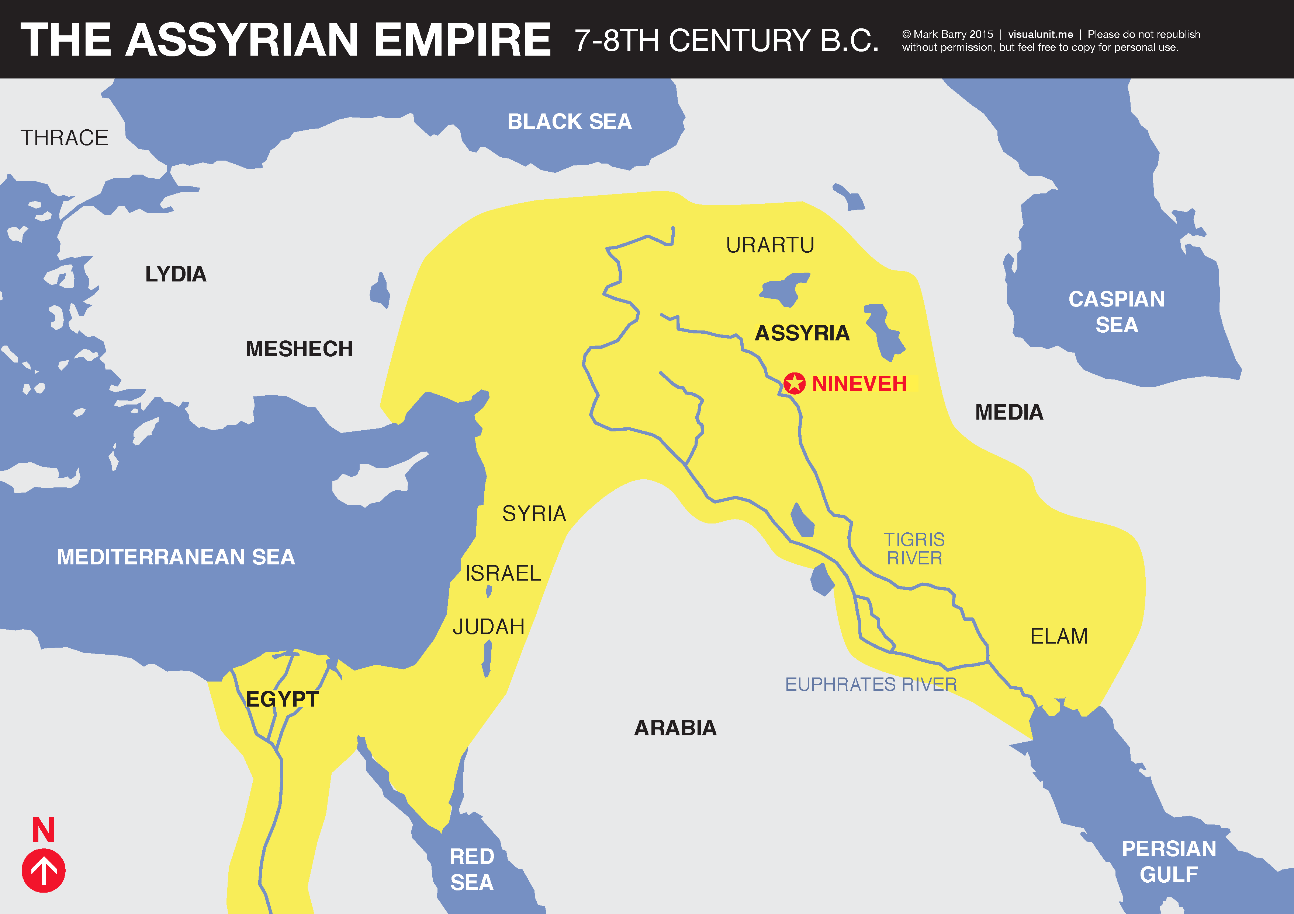
Assyrian Invasion
722 B.C.

Slide 38
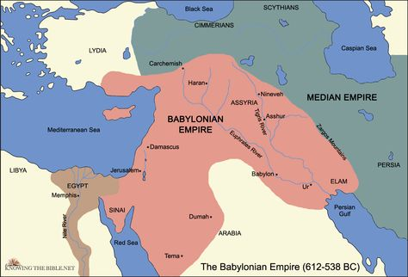
Assyrian Invasion
722 B.C.
Babylonian Invasion
605-586 B.C.

Slide 39
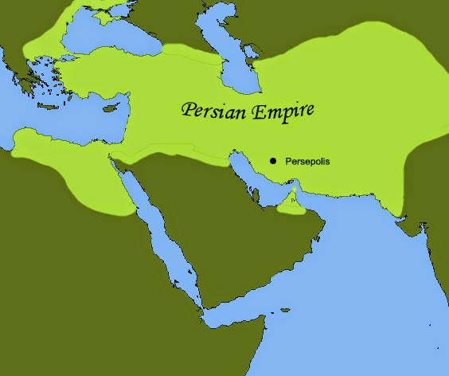
Assyrian Invasion
722 B.C.
Babylonian Invasion
605-586 B.C.
Persian Empire 539 B.C.
Notes:
N.B. Cyrus decrees in 538B.C. – approx. 150 years after Isaiah predicted it.
Generations after Isaiah’s time could test him to see if he was accurate.
Was Isaiah lucky? I don’t think so. Neither do critics.
Critics: “Isaiah was written after the fact to look like prophecy when it was really history.”
Replies: 1) “This invalidates the very point of the text.”
2) “This makes the authors liars.”
3) We turn to long range prophecy…

Slide 40
Foretelling Prophecies
Short Range – Isaiah 37:6-7
Medium Range - Isaiah 44:28
Long Range – Isaiah 53
Notes:
We get a 2 for 1 – Bible as WOG and confirmation of Jesus!

Slide 41
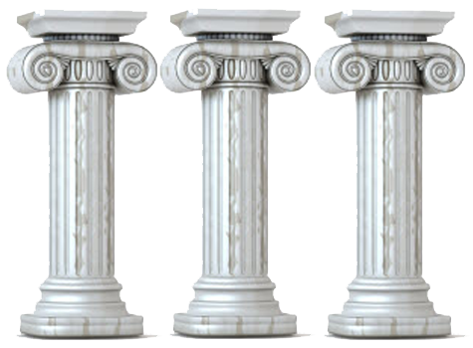
Is Jesus the Messiah?
Messiah | Jesus
52:13 “greatly exalted” | John 20:28; Rev. 19:16
52:14 “marred” | Matt. 26:67, 27:26, 29-31
52:15 “kings will shut their mouths on account of Him” | Mark 15:5; and down through history
53:2 “tender shoot…out of parched ground” | John 1:46 “Can anything good come from Nazareth?”
53:3 “despised” | Matt. 12:14 “destroy”
53:4 “surely he took up our infirmities and carried our sorrows” | Matt. 8:17 Healer
53:4 Israel “esteemed Him stricken, smitten of God” | Matt. 27:39-40
Notes:
Listen to this description of the Servant and ask, has anyone come along in history who fits this description?
52:14 – His appearance will be marred – suggesting torture.
52:15 --
53:2 – humble beginnings
53:4 – Israel rejected Him and thought God had too.

Slide 42
Is Jesus the Messiah?
Messiah | Jesus
53:5 “pierced” | John 19:34; 20:25
53:5 “by His scourging we are healed” | 1 Pet. 2:24
53:7 “led as sheep to the slaughter…did not open His mouth” | Acts 8:32-33
53:8 “By oppression and judgment He was taken away” | Mark 14:48, 14:65, 15:19-20
53:8 The Israelites of Messiah’s day didn’t consider that he was being killed for their sins. | John 1:11
58:8 Messiah died | John 19:30
Notes:
53:5 – pierced = crucifixion
53:7 = Jesus didn’t fight back at His trial.
53:8 – unjust trial

Slide 43
Is Jesus the Messiah?
Messiah | Jesus
53:9 “His grave was assigned with wicked men” | Mark 15:27
53:9 “Yet His grave was with a rich man in His death” | Matt. 27:57-60 (Joseph of Arimathea)
53:9 no injustice nor deceit | John 19:6; 1 Pet. 2:22
53:10 “He will see seed” | John 1:12
53:10 “He will prolong His days” | Matt. 28:20
53:11 His anguish turned to satisfaction | Heb. 12:2 (His shame turned to joy)
53:12 He is rewarded | Phil. 2:9-11
Notes:
53:9 – sinless
53:10 – “seed” = spiritual seed
53:10 – prolong His days = Resurrection
Isaiah may be checked for accuracy by generations far removed from him.
Isaiah didn’t just read the signs of the times. Too far away to be so specific and accurate.
Isaiah didn’t get lucky.
Isaiah 53 wasn’t written after the fact. We possess copies that predate Christianity.
Jesus didn’t align events to look like he was the fulfillment – he’d be crazy! He can’t control being rewarded, how he’s murdered, how he’s buried, resurrected!
Critic, “Jesus’ disciples made it look like He fulfilled Isa. 53. Liars.
Responses: They wrote the greatest ethic known to mankind. Are you sure you want to accuse them of lying?
No motive! Why die for a lie?!
Why lie about someone you know is a fraud and, according to Jews, was cursed by God?

Slide 44
Fear of Fabrication?
The disciples of Jesus did not manufacture a false Messiah
Liars make poor martyrs.
It is unlikely that Jews would make someone their national king who was humiliated to death by sworn enemies (the Romans.)
It is inconceivable that Jews would invent a national king who was accursed by God (hung on a tree.)
Death and resurrection was preached before earliest Christians had time to search the scriptures and build a theology.
Notes:
If Jesus didn’t rise, His earliest disciples were far more likely to see Him as a con than The King.
The martyrs were the ultimate lie detector test!

Slide 45
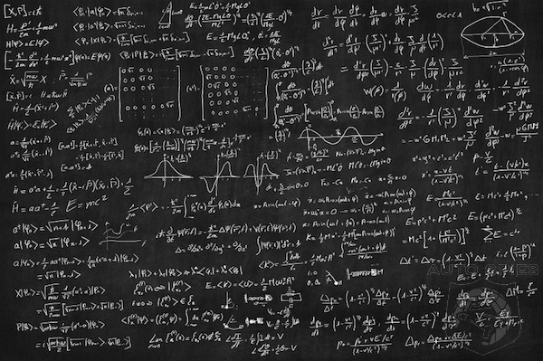
The Logic
1. The authorship of the Bible is either
purely natural or it is beyond natural.
2. It is not purely natural.
3. Therefore, it must be beyond natural.

Slide 46
Jesus
God
Law Giver
WORD OF GOD
ABSOLUTE
Written
Nature
Bible
truth

Slide 47
The Light of Christ
H.G. Wells: “I am a historian, I am not a believer, but I must confess as a historian that this penniless preacher from Nazareth is irrevocably the very center of history.”
Notes:
“by performing supernatural acts” = living a sinless, miraculous life. Raised he dead, calmed the sea, demonstrated He knew what men were thinking.
Jesus made claims to be Divine. Were they confirmed?

Slide 48
The RESURRECTION OF JESUS
F.E.A.T.
F = Fatality
E = Empty Tomb
A = Appearances
T = Transformation
Notes:
What is the best explanation of these historical facts?

Slide 49
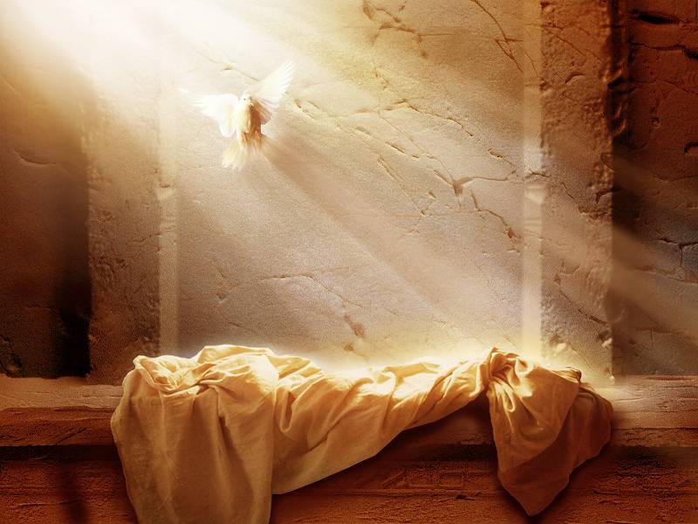
FATALITY
Nature of his wounds (whipping, crucifixion, spear)
Witnessed by friend and foe
Romans, who were professional executioners, pronounced him dead.
Numerous historical sources

Slide 50
EMPTY TOMB
The Tomb Location:
It was known (Joseph of Arimathea)
The Jerusalem Factor
The Women
The Jewish Response
Notes:
If you are going to start a movement you want people to follow, you want to come across as credible. Having women as your key eyewitnesses wouldn’t have appeared as credible in first century Judaism.

Slide 51
Appearances
Multiple people
Multiple appearances
Multiple days
Substantial extent
Doubters (disciples)
Skeptics (James)
Enemies (Paul)
Multiple sources
Early sources
Eyewitness sources
Jesus was: | Seen | Heard | Touched | Other
 | 12 | 12 | 4 | Ate food
Notes:
Over 500 witnesses at one time!
Strobel “If you were to examine every eyewitness of the R for just 15 minutes, you would hear 126 hours of testimony. Now how may people after hearing 126 hours of testimony walk away and say, “Eh, never happened. I don’t buy it.” Then Strobel adds, “I’ve seen people sent to the death chamber on just a fraction of this kind of evidence.”
12+ times seen and heard
Over a period of 40 days
Substantial – He is touched. He eats food; People have extended conversations with him.
Multiple sources – Matthew, Luke, John, 1 Cor. 15, Acts, Extra-biblical sources such as church fathers.
Early sources – 1 Cor. 15 (within months); gospels (eyewitness period). Reports were during the eyewitness period so they could be checked.
Eyewitness sources – Paul, Matthew, John

Slide 52
Transformation
From cowards, doubters, skeptics, and enemies to bold proclaimers of Jesus
Why lie to convince the world you were a coward?
Everything to lose and nothing earthly to gain
Disciples were willing to die
No one recanted
Disciples knew the truth for sure
Notes:
Some important considerations regarding the transformation of the disciples.
Everything earthly to lose – As Paul said, “I die daily” (1 Cor. 15:31)

Slide 53
F.E.A.T.
Naturalistic Hypothesis | Historical Fact Refuting NH
Swoon Theory
Conspiracy Theory
Wrong Tomb Theory
Hallucination Theory

Slide 54
F.E.A.T.
Naturalistic Hypothesis | Historical Fact Refuting NH
Swoon Theory | F. T.
Conspiracy Theory
Wrong Tomb Theory
Hallucination Theory
Notes:
Conspiracy Theory – like disciples stole the body. Or early Christians intentionally lied.

Slide 55
F.E.A.T.
Naturalistic Hypothesis | Historical Fact Refuting NH
Swoon Theory | F. T.
Conspiracy Theory | A. T.
Wrong Tomb Theory
Hallucination Theory
Notes:
Conspiracy Theory – like disciples stole the body. Or early Christians intentionally lied. Transformed to the point of death for a lie? No way.

Slide 56
F.E.A.T.
Naturalistic Hypothesis | Historical Fact Refuting NH
Swoon Theory | F. T.
Conspiracy Theory | A. T.
Wrong Tomb Theory | A. T.
Hallucination Theory

Slide 57
F.E.A.T.
Naturalistic Hypothesis | Historical Fact Refuting NH
Swoon Theory | F. T.
Conspiracy Theory | A. T.
Wrong Tomb Theory | A. T.
Hallucination Theory | E. A.
Supernatural Hypothesis
Jesus Resurrection
Notes:
What do critics today say happened? “Something happened.”
Yes, the resurrection!

Slide 58
Jesus
God
Living
Law Giver
WORD OF GOD
ABSOLUTE
Written
Nature
Bible
truth
Notes:
Final appeal: If what we’ve said is true, Christianity is true and everything opposed to it is false. Christianity should be believed even if you are have uncertainty in other areas of theology.
To believers, be ready. Be able to present an evidential case. A dying world needs life. Jesus is life!
To unbelievers, consider this case. If you find it compelling, trust Christ now.
Believing that v. Believing in

